Slide 1

AyurPharma: Integrating Traditional Knowledge with Modern Medicines
Major Project (8th Semester)
Abhishek Shakya
Akshat Sharma
Anoop Kumar Singh
Gaurav Yadav
Computer Science and Information Technology KIET Group of Institutions, Ghaziabad
Supervised by: Mr. Madhukar
MAY 4, 2026
AyurPharma

Slide 2
Introduction
AyurPharma: AI-Driven Personalized Healthcare
Ayurveda → Ancient Indian system focused on personalized medicine
Based on Prakriti (body constitution): Vata, Pitta, Kapha
Modern healthcare → generalized treatment approach
Rise in lifestyle diseases → need for preventive care
AI technologies enable:
Pattern detection
Predictive insights
Personalized recommendations
Idea: Integrating Ayurveda with AI for intelligent healthcare solutions
AyurPharma

Slide 3
Problem Statement and Objectives
Problem Statement
Ayurvedic knowledge is unstructured & difficult to digitize
Lack of integration with modern AI systems
Existing solutions:
Limited datasets
Low scalability
Lack clinical validation
Objectives
Build AI-based personalized healthcare system
Use NLP to process Ayurvedic texts
Apply ML for:
Prakriti classification
Treatment recommendation
Implement RAG + LLM for context-aware responses
Ensure scalability & interpretability
AyurPharma

Slide 4
Literature Review
S.No | Author & Year | Algorithm | Metrics | Dataset | Findings | Gaps
1 | Balachandran & Govindarajan (2007) | Ayurvedic drug discovery | Conceptual review (no specific metrics) | Traditional Ayurvedic texts & phytochemical data | Highlighted potential of Ayurveda in modern drug discovery | Lack of computational models and clinical validation
2 | Patwardhan et al. (2017) | Policy recommendations for Ayurveda formulations safety | Case reports, toxicity observations | Clinical reports, national pharmacovigilance data | Proposed guidelines for safer Ayurveda drug use | No algorithmic/ML-based solutions, need for tech integration
3 | Sudheer Kumar et al. (2024) | Decision Tree, Random Forest, KNN | Confusion Matrix, Cross Validation | Kaggle dataset + Ayurvedic constitution data | Developed Ayurvedic disease prediction & drug recommendation system | Limited dataset, lacks real-world clinical trial validation
4 | Singh et al. (2018) | Big Data Analytics | Network analysis, statistical evaluation | 353,000 Ayurveda patient records | Showed chronic disease patterns & Ayurveda effectiveness (76% relief) | Dataset limited to single Ayurveda network, needs multi-institution validation
5 | Verma et al. (2024) | Conceptual Integration Framework | Qualitative synthesis | Classical Ayurvedic texts + modern medical literature | Explored integration of Ayurveda with modern medicine | Standardization and lack of scientific validation remain
AyurPharma

Slide 5
Literature Review
6 | Gupta (2024) | Integrative Healthcare Model | Comparative analysis | Review of Ayurveda + Modern medicine practices | Outlined strategies for integrating Ayurveda & modern medicine | Barriers: regulation, training, standardization
7 | Maniruzzaman et al. (2025) | Integrative Sports Medicine | Review of clinical & experimental findings | Sports medicine + Ayurvedic therapy literature | Highlighted benefits of Ayurveda (Ashwagandha, Turmeric, Panchakarma) for athletes | Lack of large-scale clinical trials, standardization challenges
8 | Patil et al. (2022) | AI, ML, DL (Neural Networks, Fuzzy Systems, Evolutionary Computation) | Accuracy, efficiency metrics | Medical datasets (not specific to Ayurveda) | AI successfully applied in healthcare for disease prediction | Not directly applied to Ayurveda, gap in Ayurveda-specific AI models
9 | International Journal of Ayurveda Research (2023) | AI in Ayurveda (NLP, ML, Big Data, Blockchain) | Review-based evaluation | Conceptual + WHO reports + case studies | Highlighted opportunities for AI-driven Ayurveda | Need for real implementations & datasets
10 | Xu (2024) | Traditional Chinese Medicine (Comparative framework) | Qualitative synthesis | Ancient TCM texts + modern healthcare practices | Provided parallels between TCM & Ayurveda integration | Limited to TCM, but useful for Ayurveda comparative insights
AyurPharma

Slide 6
Proposed Algorithm and Methodology
Data Sources
Ayurvedic texts (Charaka, Sushruta)
Clinical datasets
User symptom inputs
NLP Pipeline
Text preprocessing (NLTK, spaCy)
Entity extraction (disease, herbs)
Embeddings (Sentence Transformers)
RAG Framework
FAISS → semantic retrieval
LLM → response generation
ML Models
K-Means → Prakriti classification
Decision Tree → treatment recommendation
Workflow: Input → NLP → Clustering → Classification → LLM Output
AyurPharma

Slide 7
Implementation Details
Front-End: React and Tailwind CSS for symptom input and Prakriti questionnaire.
Back-End: Node.js with Python integration for the ML pipeline (LLM Models).
Database: MongoDB for secure storage of herbal and user data.
AyurPharma

Slide 8
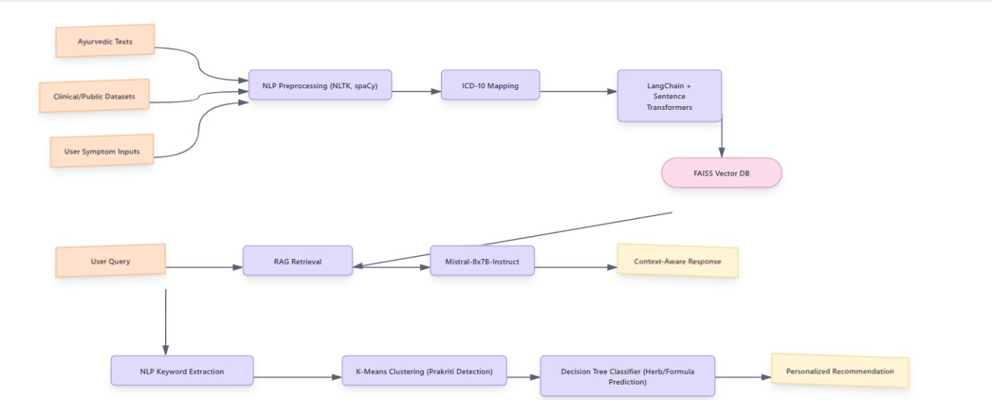
Flowchart
2.
AyurPharma

Slide 9
Results and Discussions (1/3)
Model Performance
Accuracy: 84–87%
High agreement with expert evaluation
User Feedback
90% users found recommendations relevant
Key Strengths
Context-aware responses
Personalized healthcare insights
Improved interpretability using knowledge graphs
AyurPharma

Slide 10
Results and Discussions (2/3)
Performance Metrics
Top-1 Accuracy: 0.81
Top-3 Accuracy: 1.00
Top-5 Accuracy: 1.00
End-to-End Accuracy: 0.84
Observations
High symptom detection accuracy
Scalable and stable system
Multi-model approach improves performance
AyurPharma

Slide 11
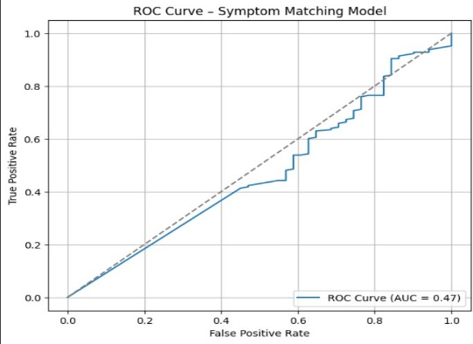
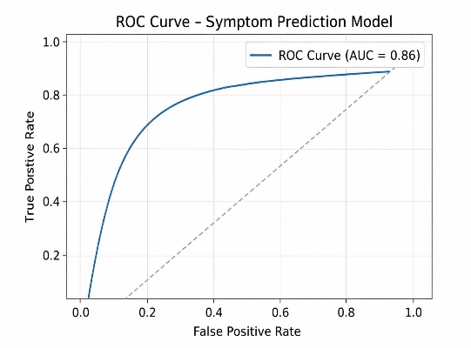
Results and Discussions (3/3)
ROC CURVE 1
ROC CURVE 2
AyurPharma

Slide 12
Conclusion and Future Scope
Conclusion
Successfully integrates Ayurveda + AI + ML + NLP
Provides:
Personalized recommendations
Scalable & interpretable system
Demonstrates real-world applicability
Future Scope
Clinical trials & validation
Multilingual NLP support
Integration with:
Wearables & IoT
Electronic Health Records (EHR)
Improved data standardization & ethics
AyurPharma

Slide 13
Key References
[1] P. Balachandran and R. Govindarajan, "Ayurvedic drug discovery: potentials and challenges," Dept. of Phytochemistry, Central Re-search Institute of Ayurveda, India, 2007.
[2] B. Patwardhan, A. Vaidya, M. Chorghade, et al., "Policy recommen-dations for Ayurveda formulations safety," Interdisciplinary School of Health Sciences, Pune University, India, 2017.
[3] R. Sudheer Kumar, P. Sharma, V. Nair, and S. Gupta, "Development of an Ayurvedic disease prediction and drug recommendation system using ML models," IIT Delhi, India, 2024.
[4] H. Singh, A. Sharma, S. Bhardwaj, et al., "Big data analytics of Ayurveda: evidence from 353,000 patient records," New Delhi Institute of Medical Sciences, India, 2018.
[5] A. Verma, R. Sinha, and K. Yadav, "Conceptual framework for Ayurveda integration with modern medicine," BHU, India, 2024.
2.
AyurPharma

Slide 14
Key References
[6] R. Gupta, "Integrative healthcare models: Bridging Ayurveda and modern medicine," AIIMS, New Delhi, India, 2024.
[7] M. Maniruzzaman, A. Das, and S. Rahman, "Ayurveda in sports medicine: clinical and experimental findings," Dhaka University, Bangladesh, 2025.
[8] R. R. Patil, U. Ruby, C. B. N., S. Jain, and G. K., "Artificial Intelligence in Healthcare: Applications of ML, DL, and Fuzzy Systems," GITAM School of Tech., India; VIT Bhopal University, India, 2022.
[9] International Journal of Ayurveda Research, "Artificial Intelligence in Ayurveda: Opportunities and challenges," Editorial Board, Ministry of AYUSH, Govt. of India, 2023.
[10] Z. Afsar, N. R., V. K. R., S. K., M. Manjunatha, R. P. M., and G. B., "Modern Concepts of Integrating Artificial Intelligence with Traditional and Herbal Medicine: A Review," Int. J. Sci. R. Tech., vol. 2, no. 2, pp. 43–49, 2025
AyurPharma

Slide 15
Thank You!
Questions?
AyurPharma

